Slide 1
SESSION 1

Slide 2
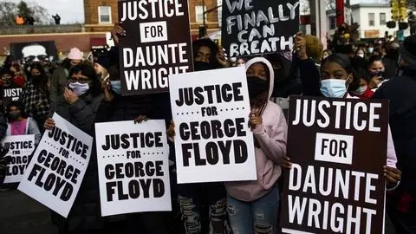
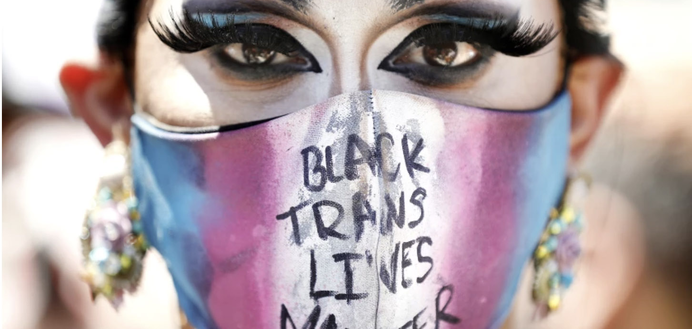
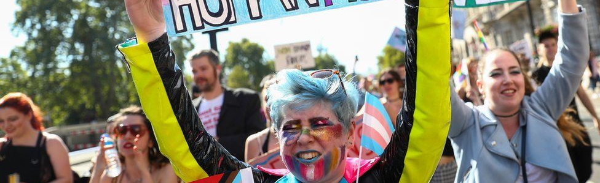

Slide 3
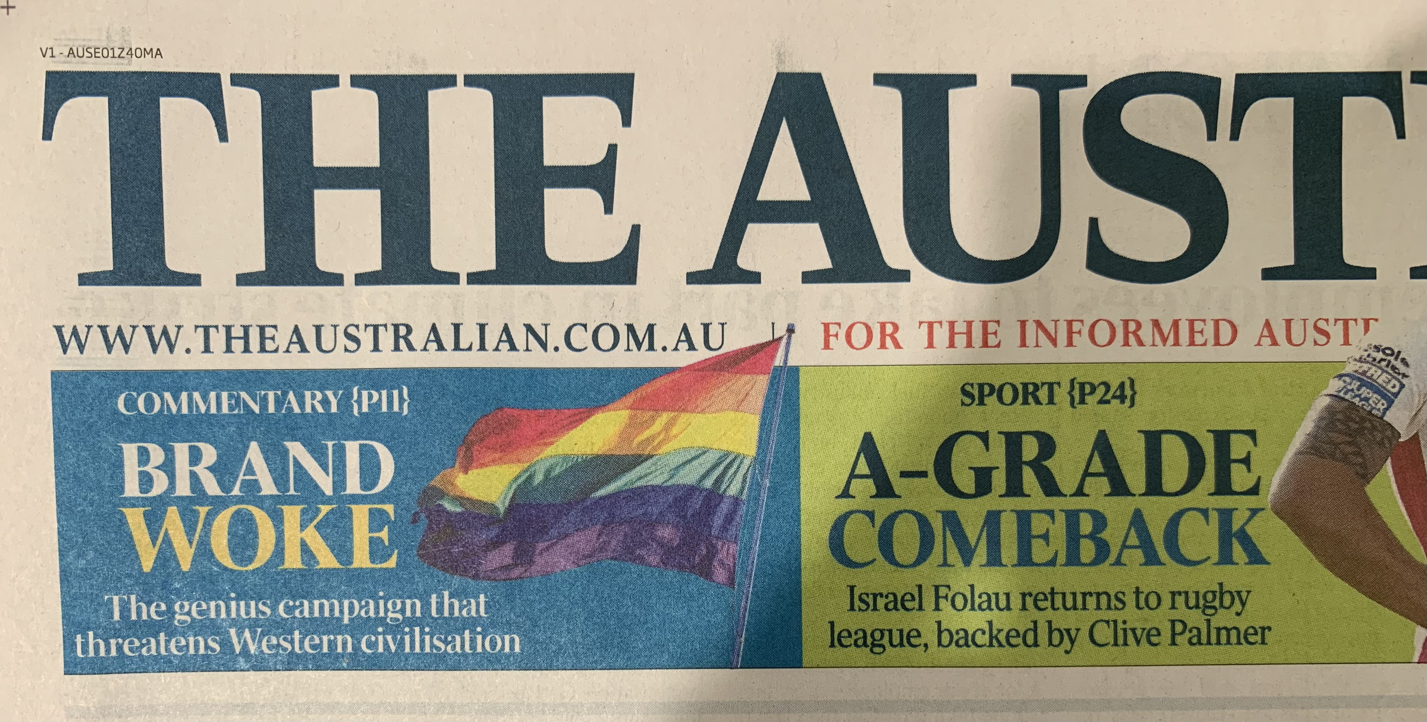

Slide 4
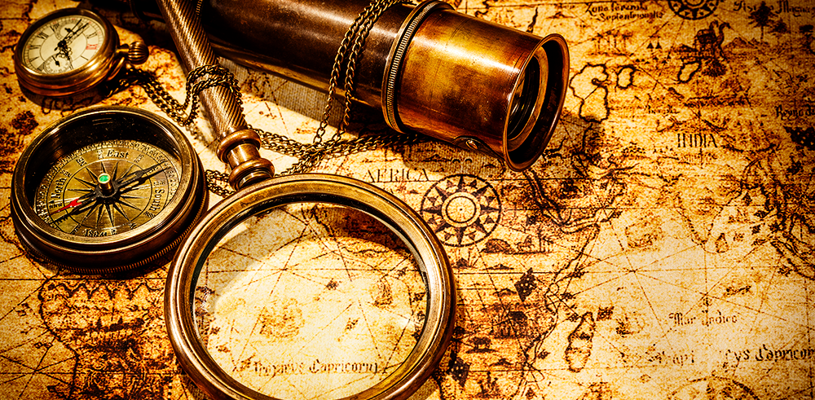

Slide 5
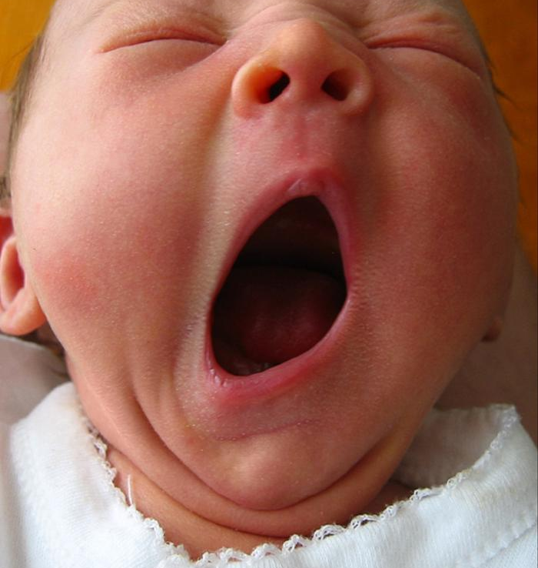
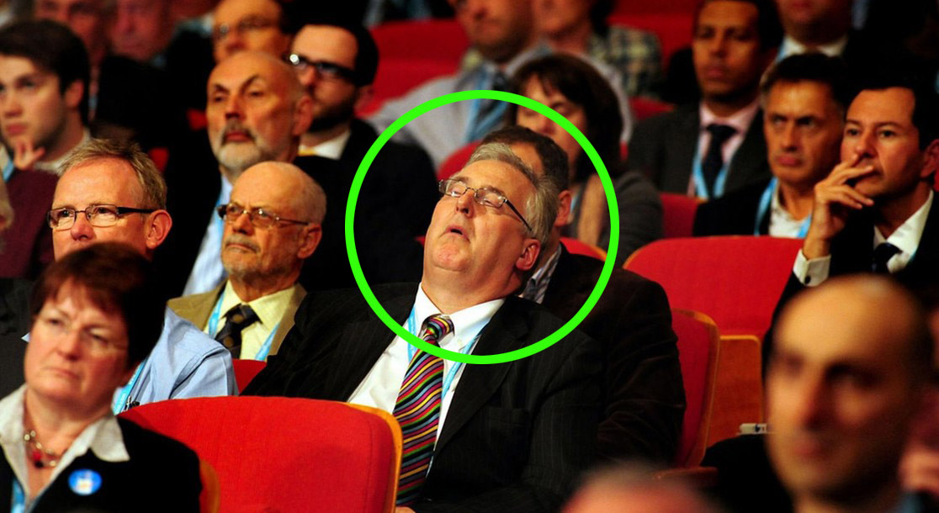
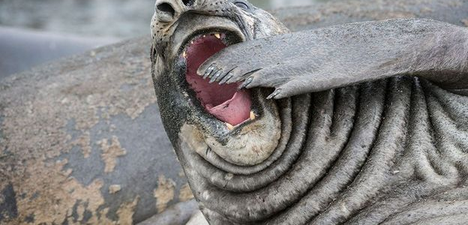

Slide 6
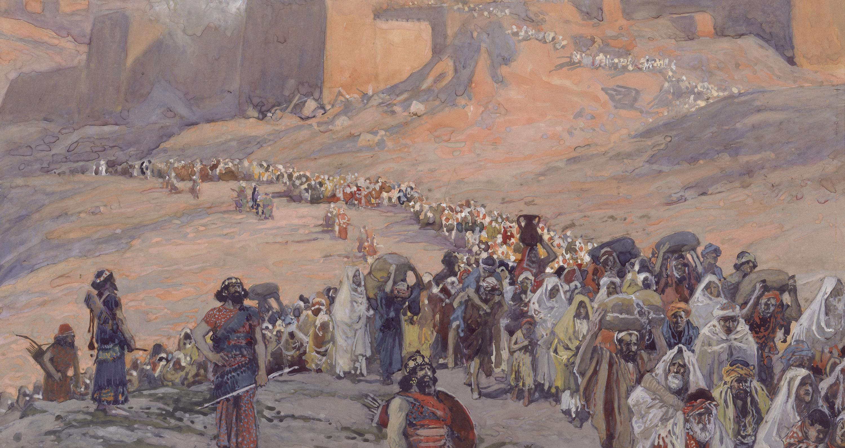
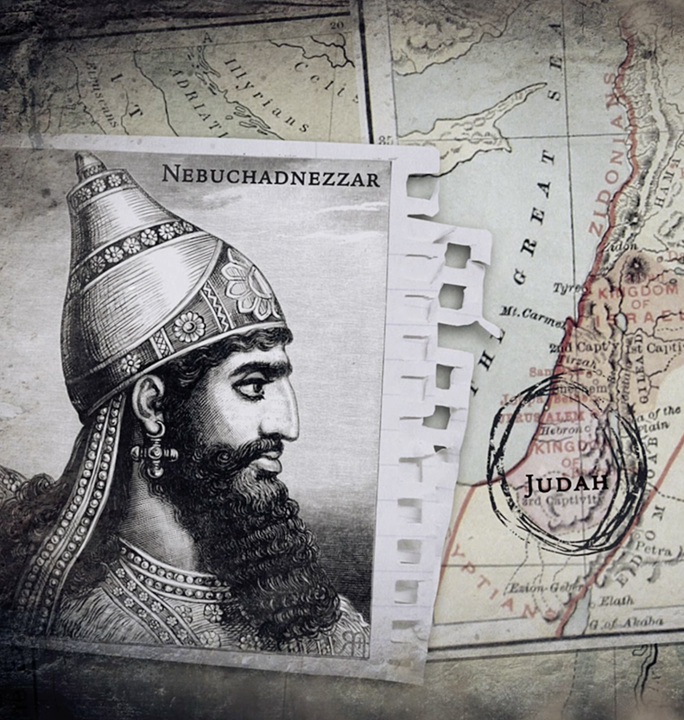
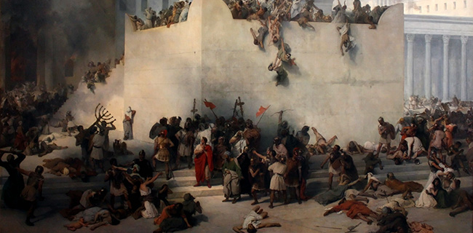

Slide 7
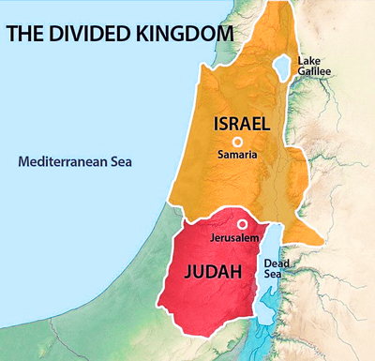

Slide 8
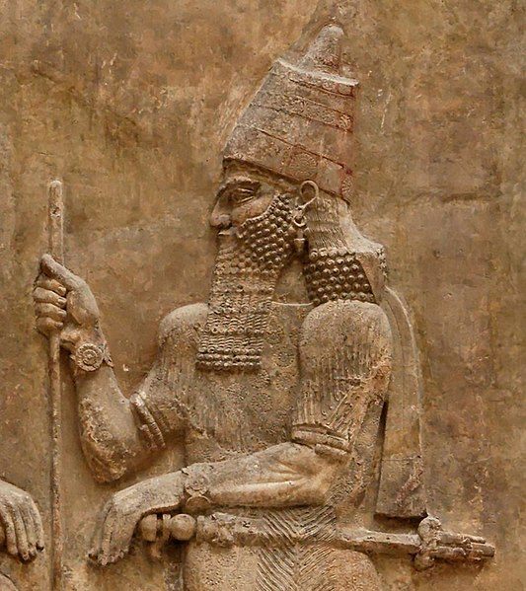
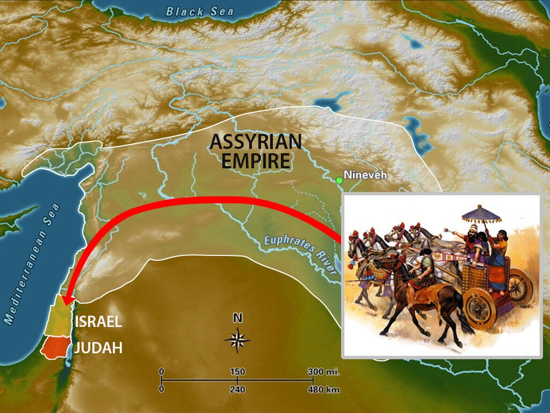
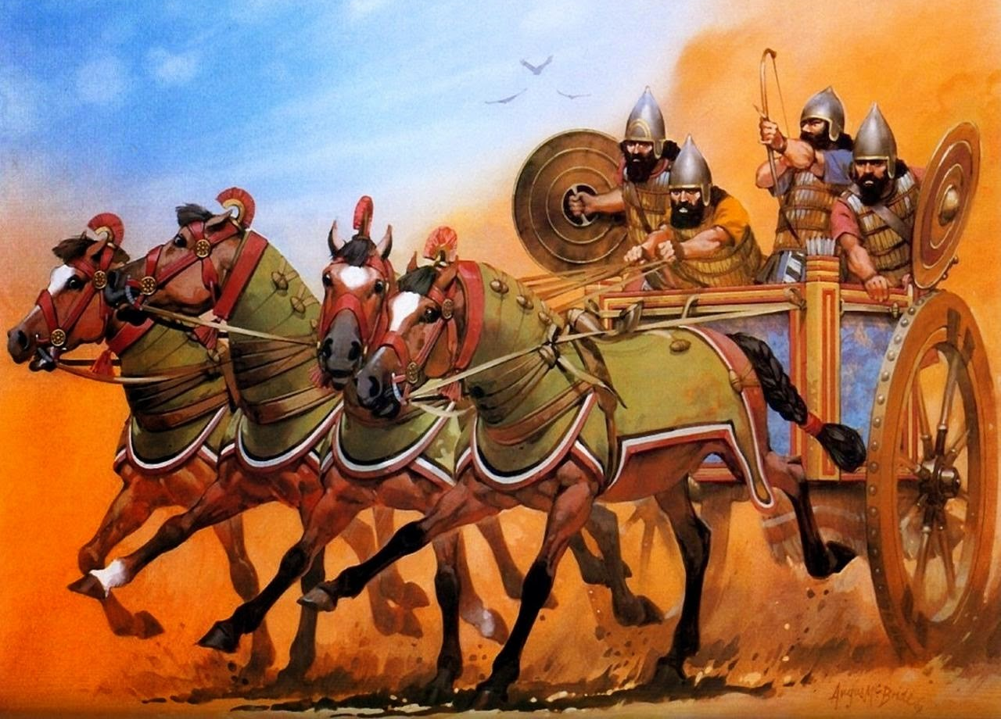

Slide 10
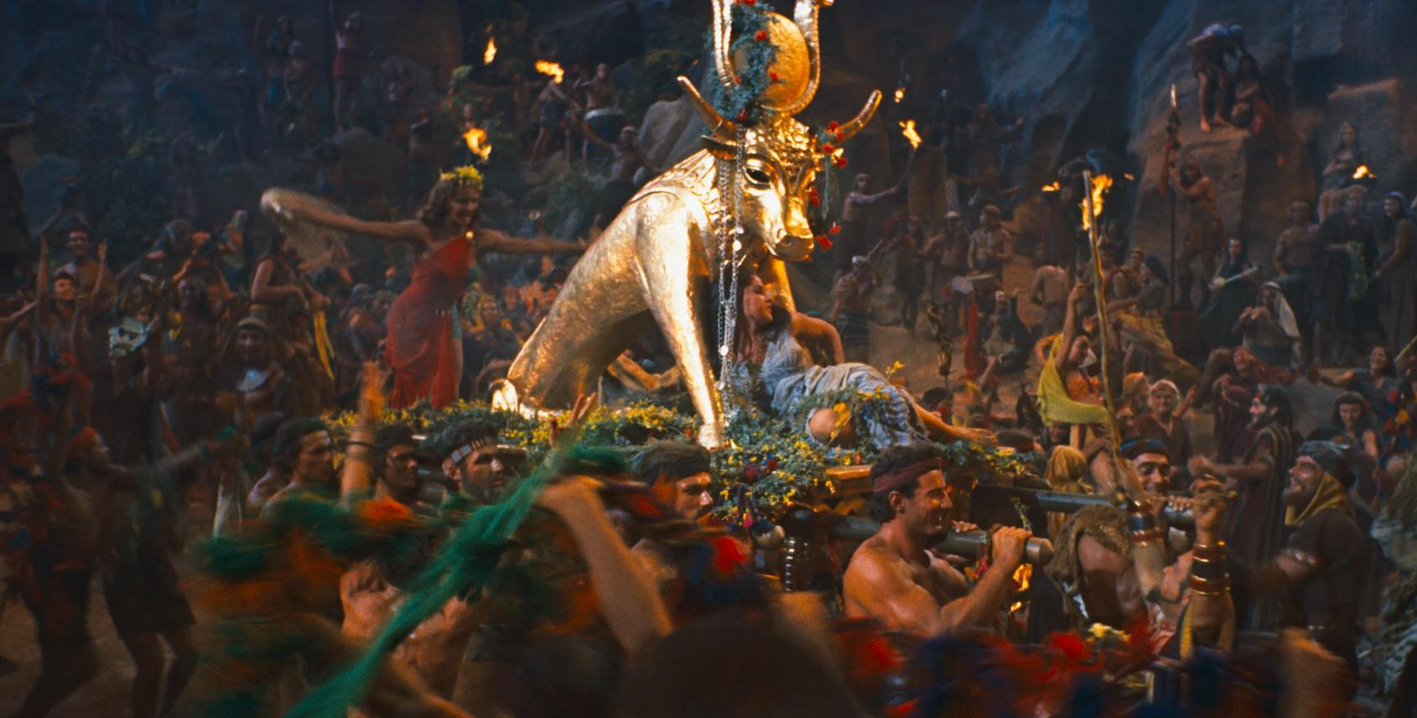

Slide 11
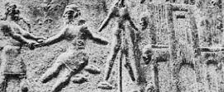
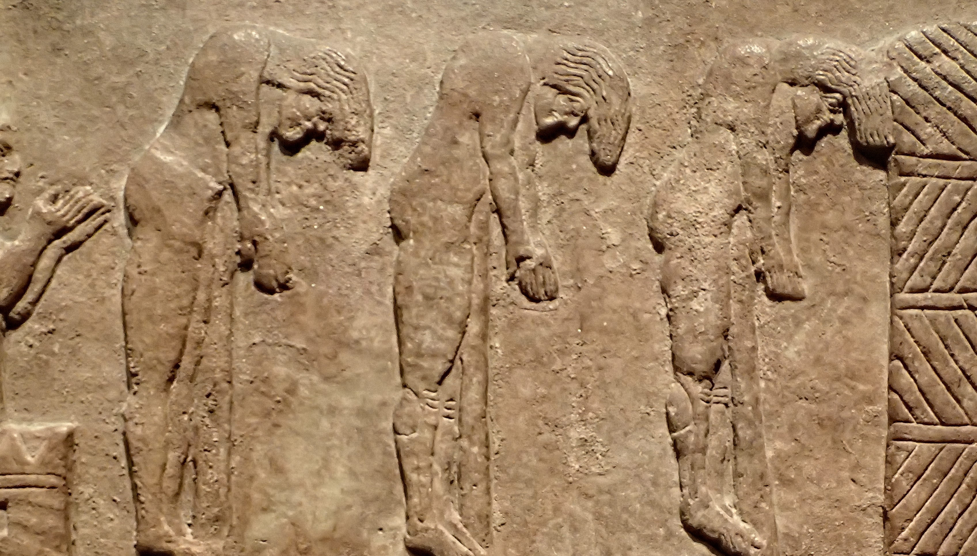
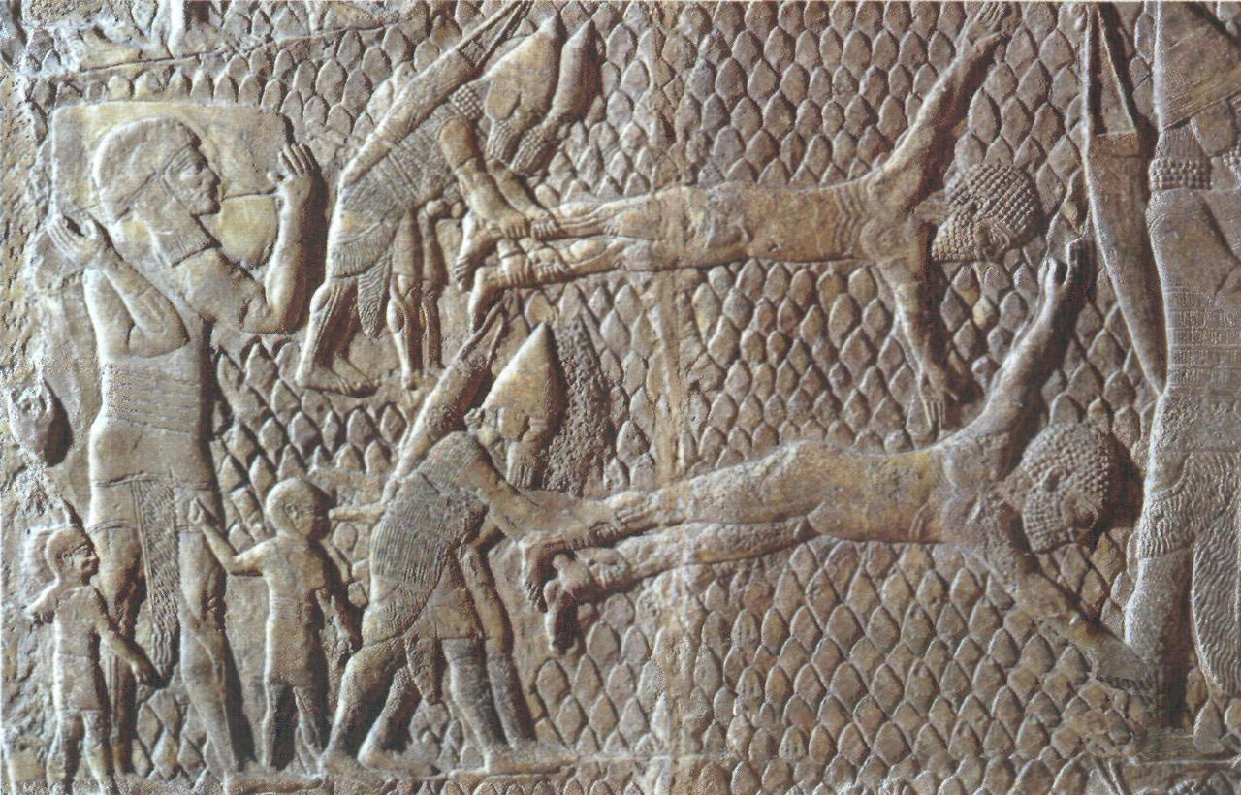
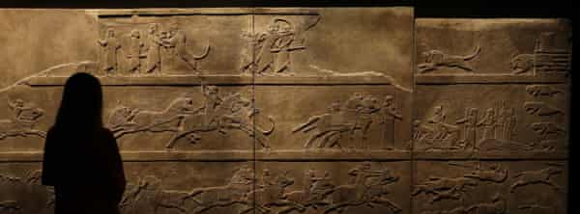

Slide 13
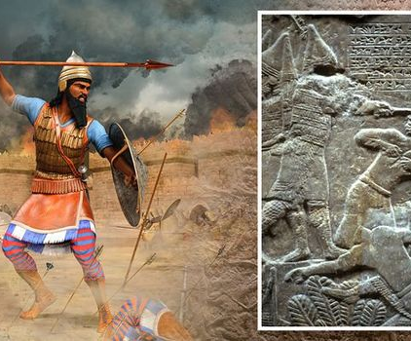
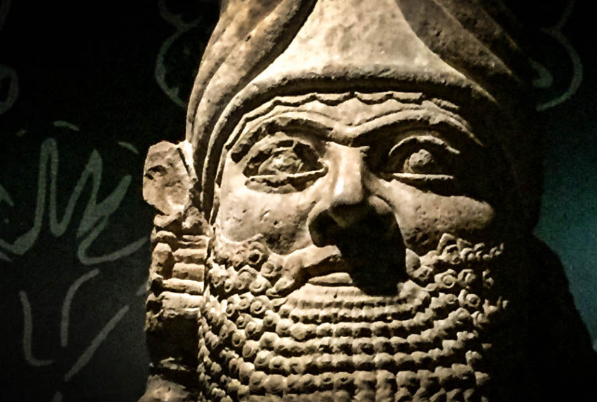

Slide 14
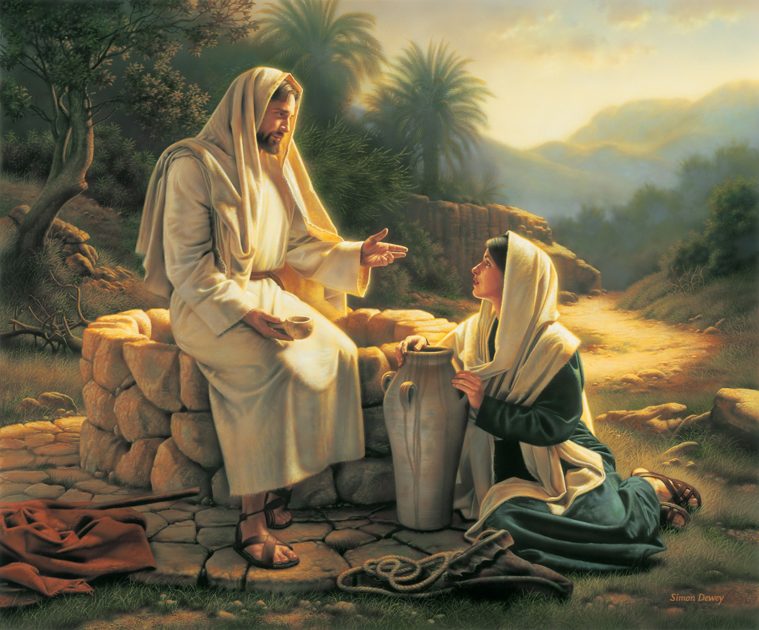

Slide 15
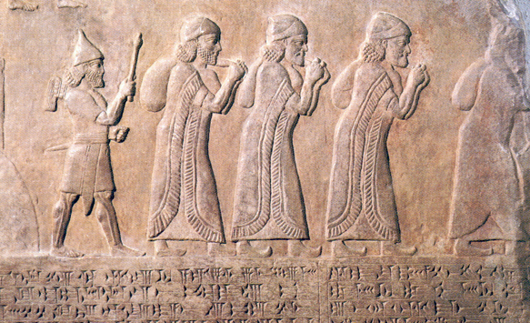
The Diaspora

Slide 16
Babylonian Invasion

Slide 17
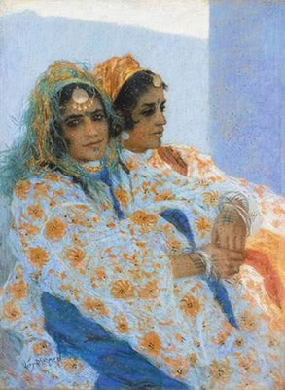
Oholah & Oholibah

Slide 18
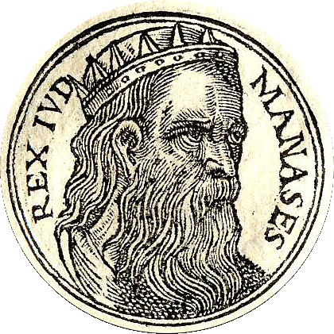

Slide 19
2 Kings 21
Manasseh seduced the people to do more evil than the nations whom the Lord had destroyed …he has acted more wickedly than all the Amorites who were before him, and has also made Judah sin with his idols”

Slide 20
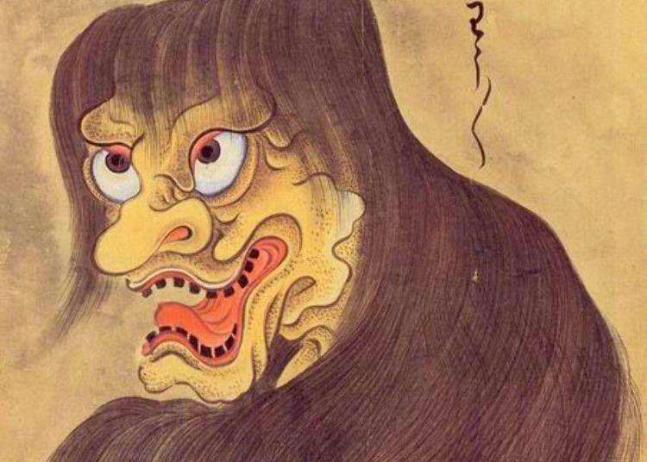

Slide 21
Romans 12:9-21
.. 9 Let love be genuine. Abhor what is evil; hold fast to what is good. 10Love one another with brotherly affection. Outdo one another in showing honor. 11 Do not be slothful in zeal, be fervent in spirit, serve the Lord. 12 Rejoice in hope, be patient in tribulation, be constant in prayer. 13 Contribute to the needs of the saints and seek to show hospitality.
V21 21Do not be overcome by evil, but overcome evil with good.

Slide 22
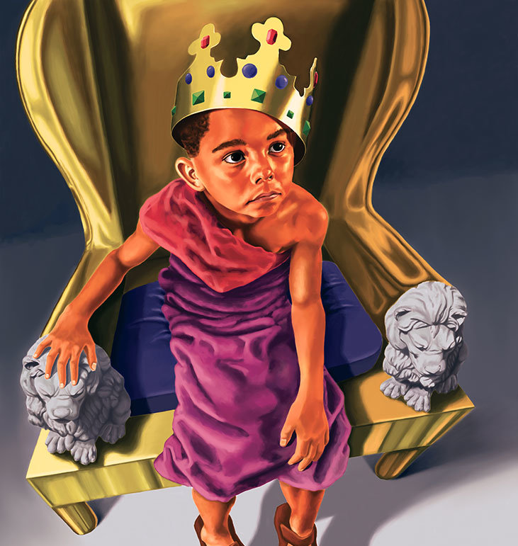
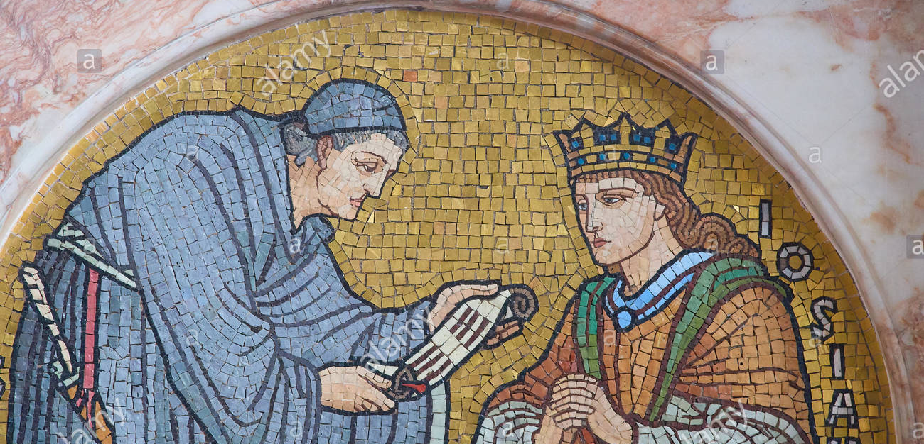

Slide 23
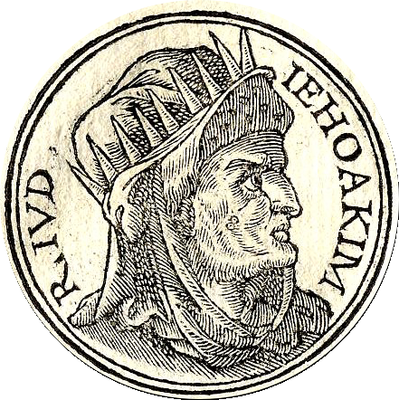

Slide 24
SESSION 2

Slide 25
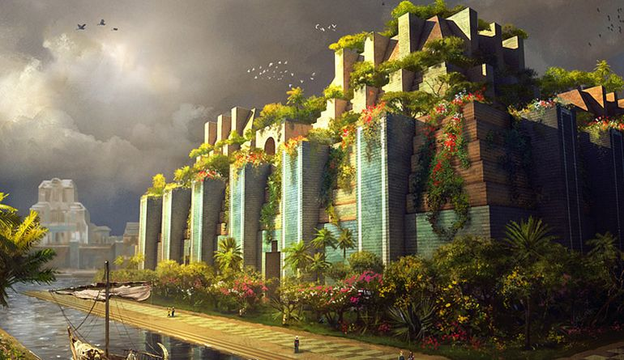
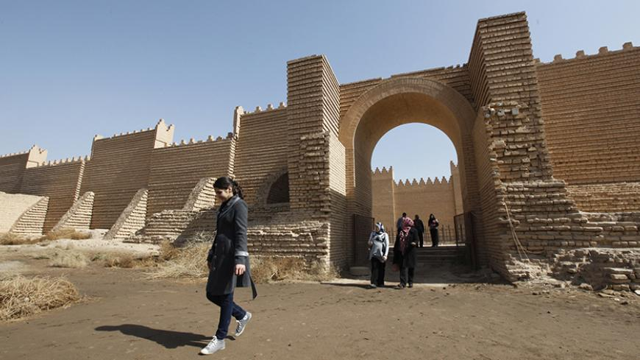

Slide 26
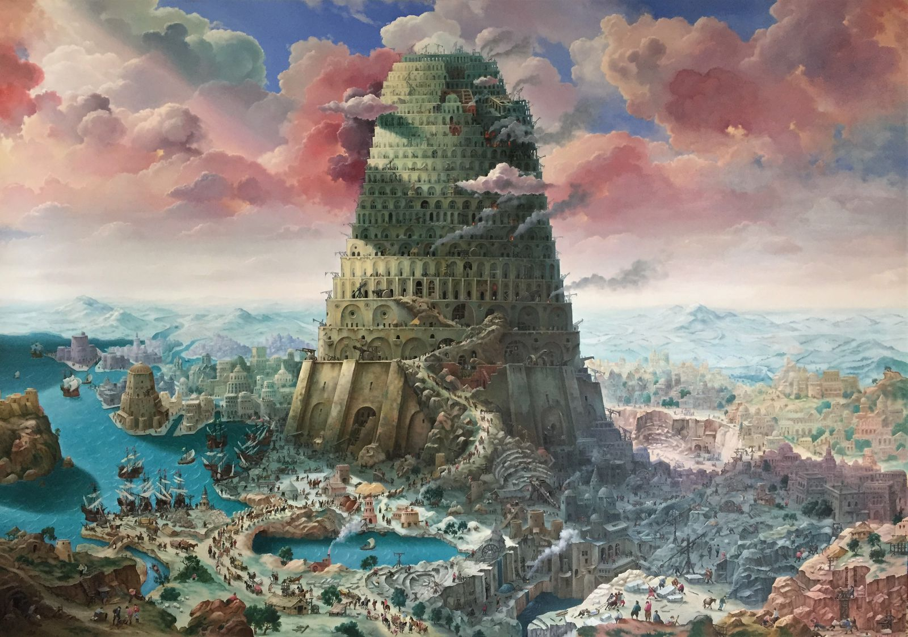
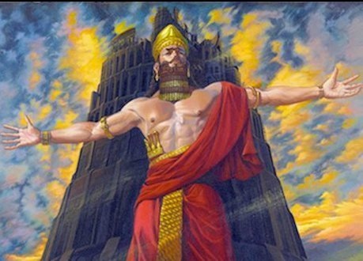
Nimrod

Slide 27
Gen 11
“5 …the LORD came down to see the city and the tower that the sons of men were building. 6 And the LORD said, “If they have begun to do this as one people speaking the same language, then nothing they devise will be beyond them…Come, let Us go down and confuse their language, so that they will not understand one another’s speech.”

Slide 28
Jeremiah 23:7-8
“Therefore, behold, the days are coming, declares the LORD, when they shall no longer say, ‘As the LORD lives who brought up the people of Israel out of the land of Egypt,’ but ‘As the LORD lives who brought up and led the offspring of the house of Israel out of the north country and out of all the countries where he had driven them.’ Then they shall dwell in their own land.”

Slide 29
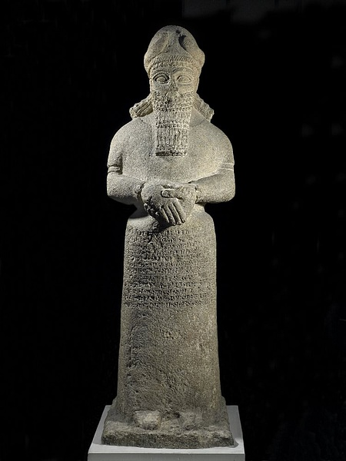

Slide 32
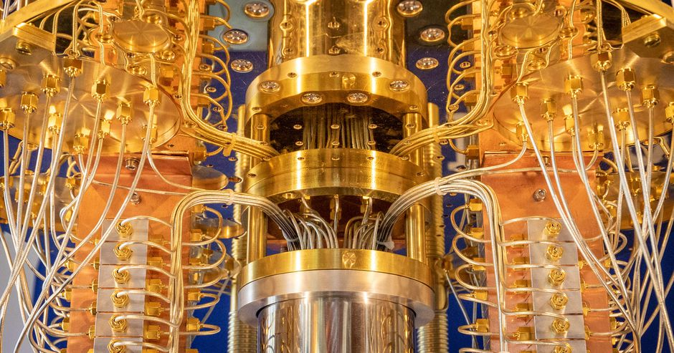

Slide 33
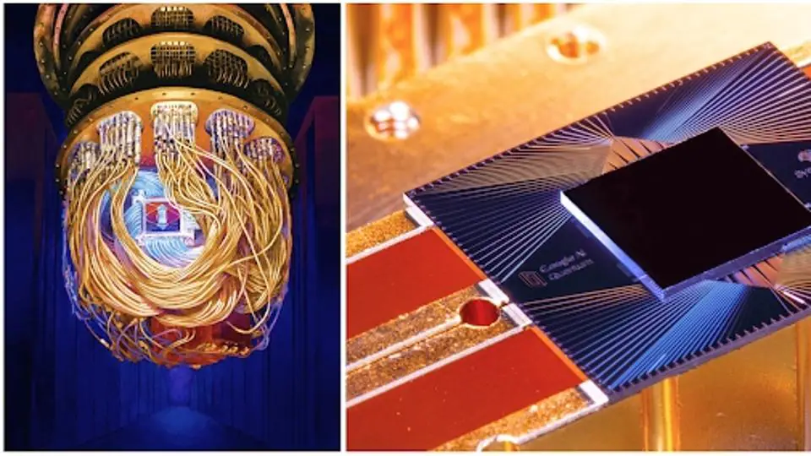

Slide 34
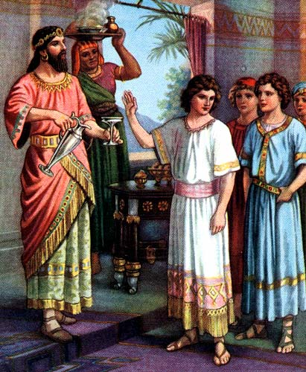

Slide 35
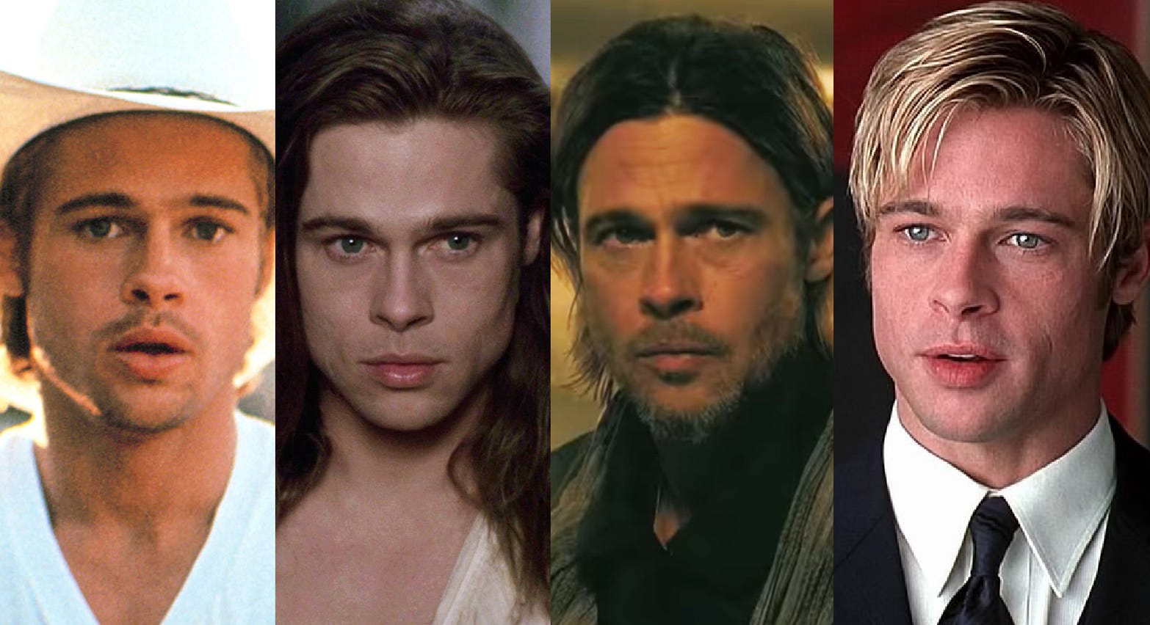

Slide 38
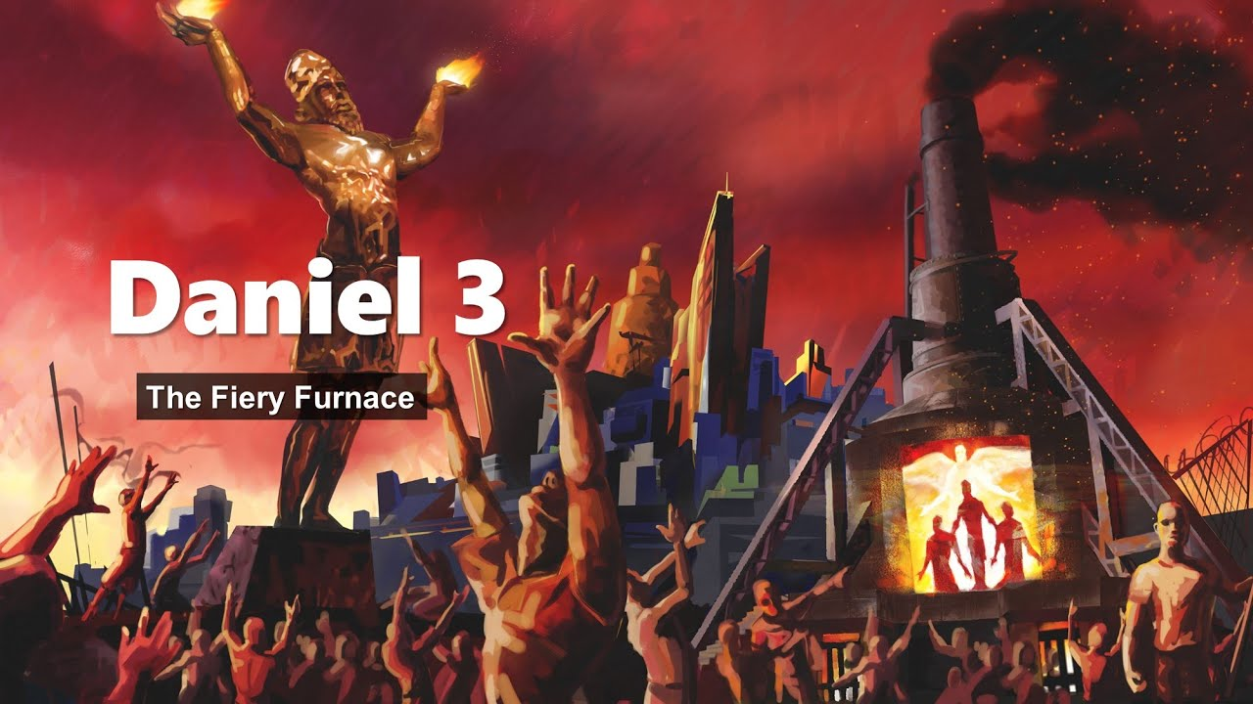
SESSION 3

Slide 39
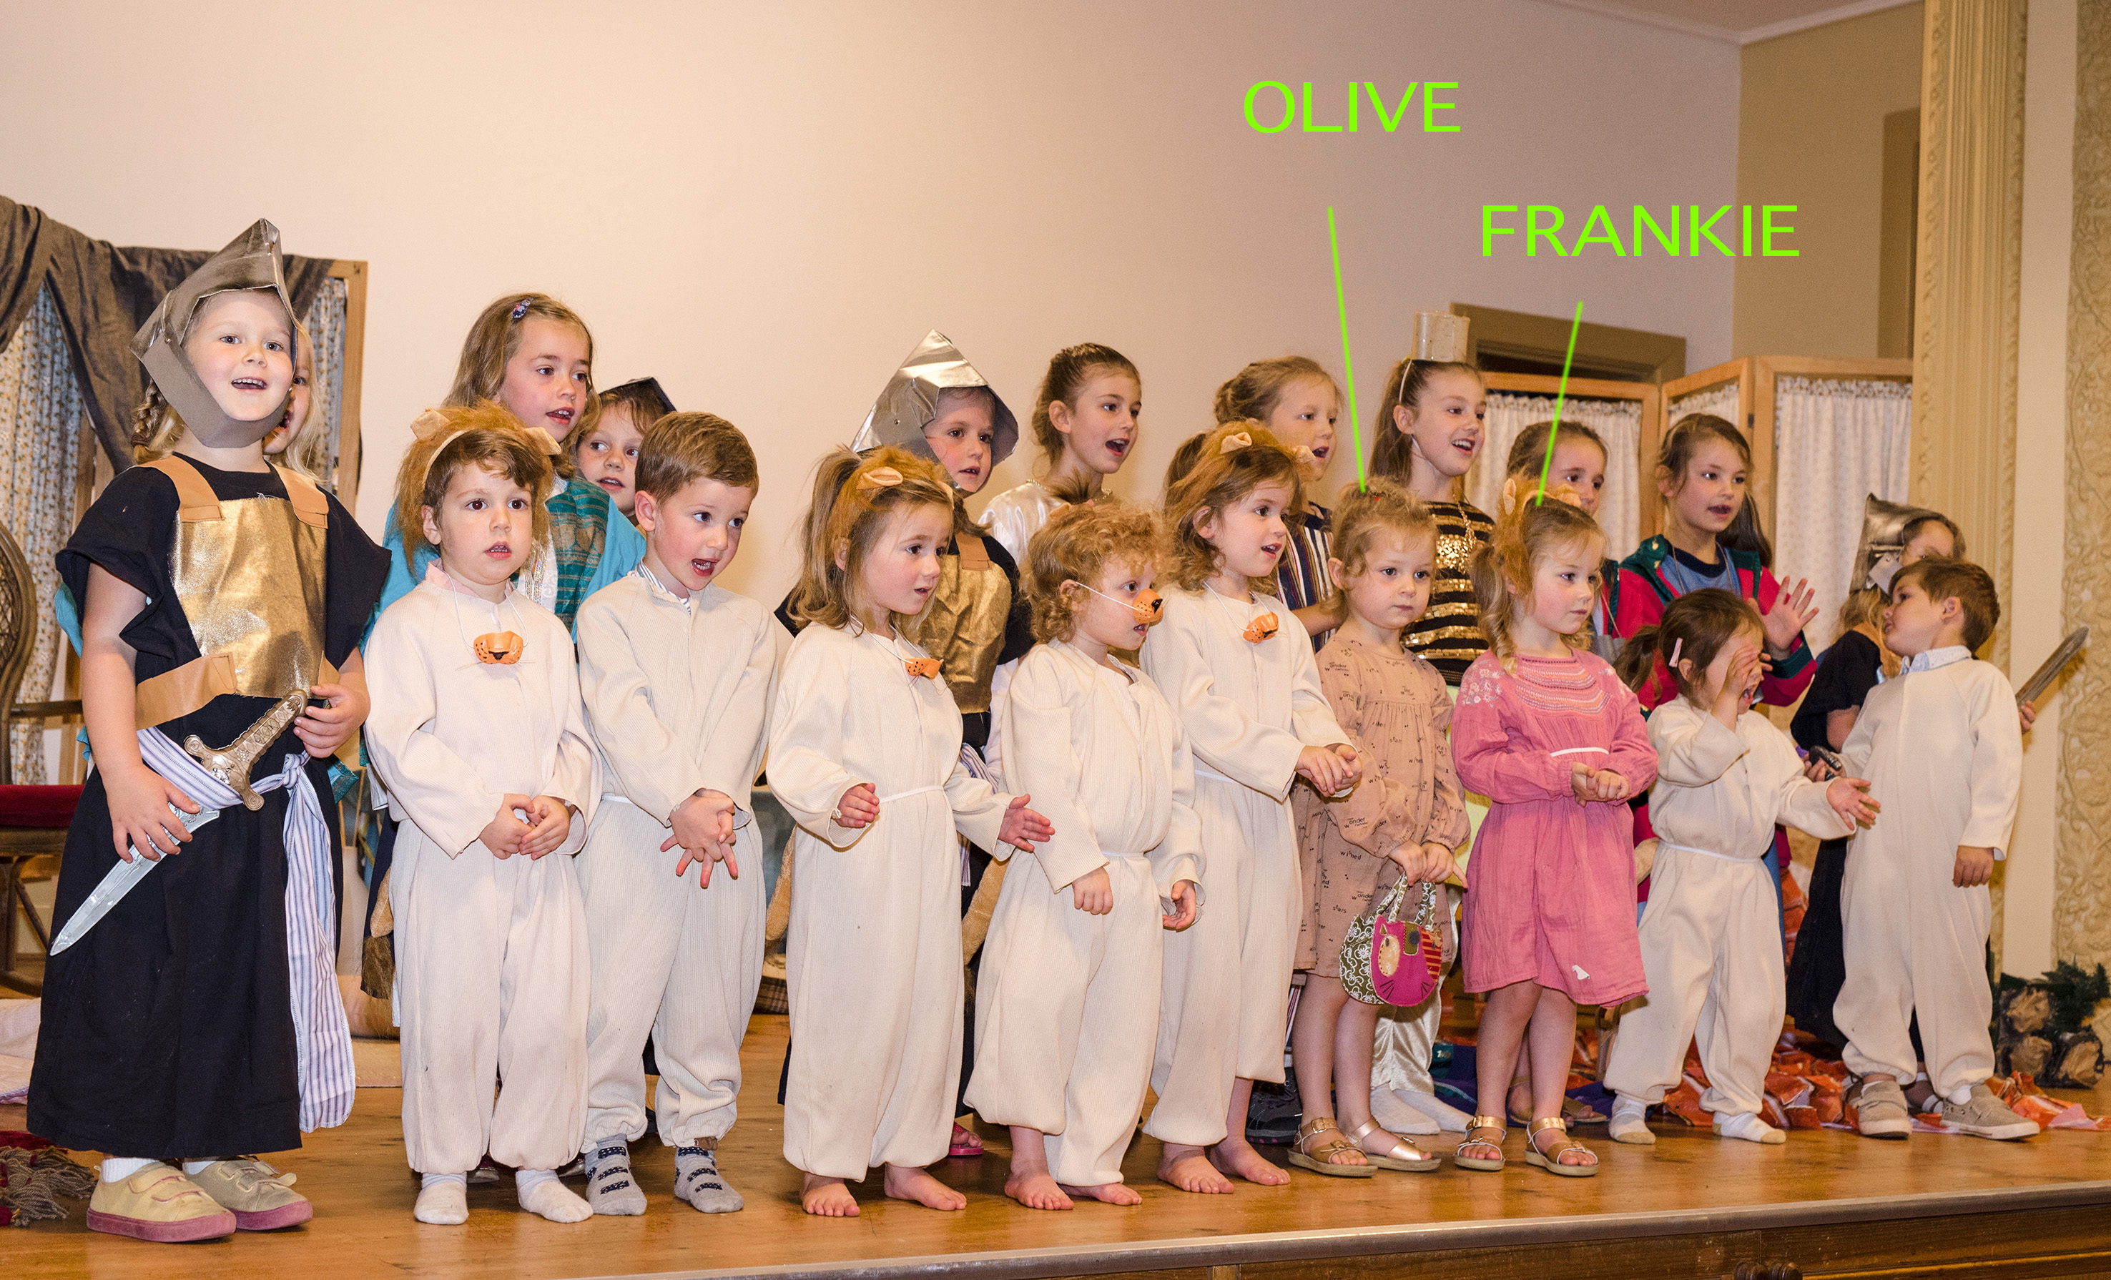

Slide 41
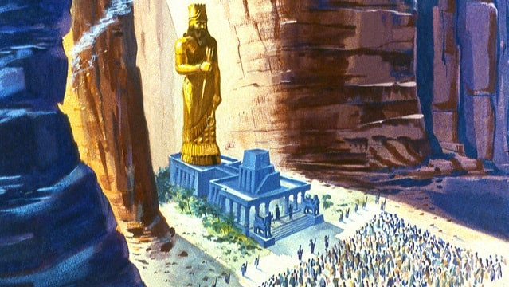

Slide 42
1 Peter 1:3-9
3 Blessed be the God and Father of our Lord Jesus Christ! According to his great mercy, he has caused us to be born again to a living hope through the resurrection of Jesus Christ from the dead, 4 to an inheritance that is imperishable, undefiled, and unfading, kept in heaven for you, 5 who by God’s power are being guarded through faith for a salvation ready to be revealed in the last time. 6 In this you rejoice, though now for a little while, if necessary, you have been grieved by various trials, 7 so that the tested genuineness of your faith—more precious than gold that perishes though it is tested by fire—may be found to result in praise and glory and honor at the revelation of Jesus Christ. 8 Though you have not seen him, you love him. Though you do not now see him, you believe in him and rejoice with joy that is inexpressible and filled with glory, 9 obtaining the outcome of your faith, the salvation of your souls.

Slide 43
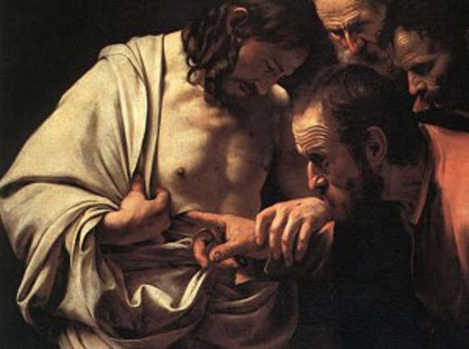

Slide 44
Romans chapter 5:7-8
7.For scarcely for a righteous man will one die; yet perhaps for a good man someone would even dare to die. 8 But God demonstrates His own love toward us, in that while we were still sinners, Christ died for us.

Slide 45
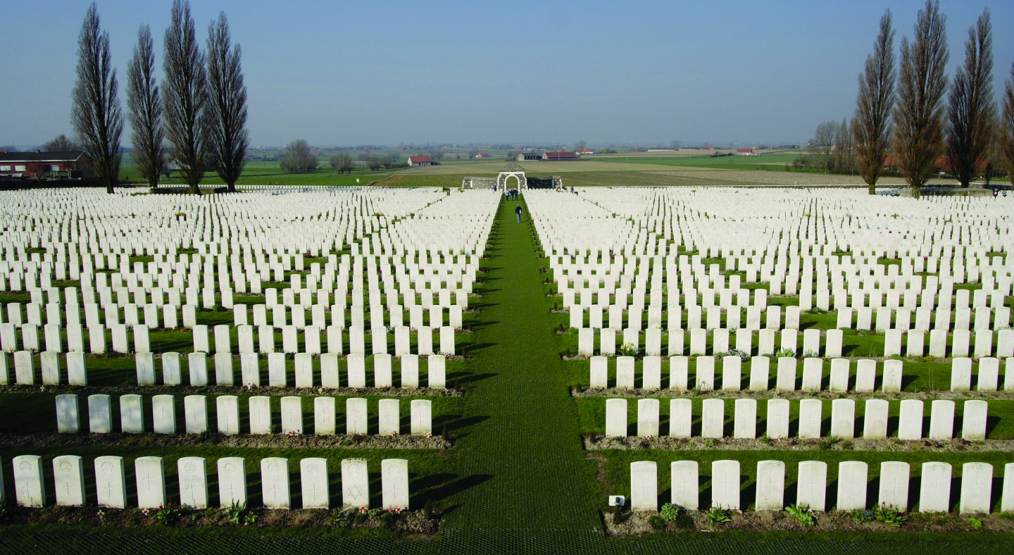

Slide 46
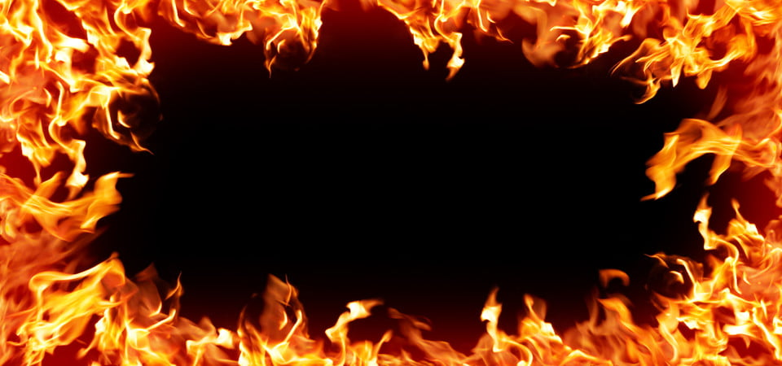

Slide 47
Daniel 1:3
“young men in whom there was no blemish, good-looking, gifted in all wisdom, possessing knowledge and quick to understand, who had ability to serve in the king’s palace, and whom they might teach the language and [literature of the Chaldeans.

Slide 48
Isaiah 53:2
“He had no beauty or majesty to attract us to him, nothing in his appearance that we should desire him.
He was despised and rejected by mankind, a man of suffering, and familiar with pain. Like one from whom people hide their faces he was despised, and we held him in low esteem”

Slide 49
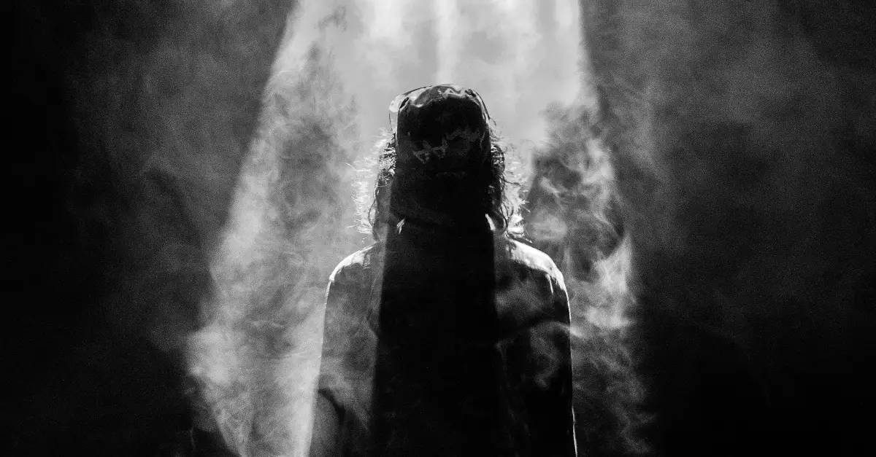
Isaiah 52:14
his appearance was so marred, (His face was so disfigured) he seemed hardly human, and from his appearance, one would scarcely know he was a man

Slide 50
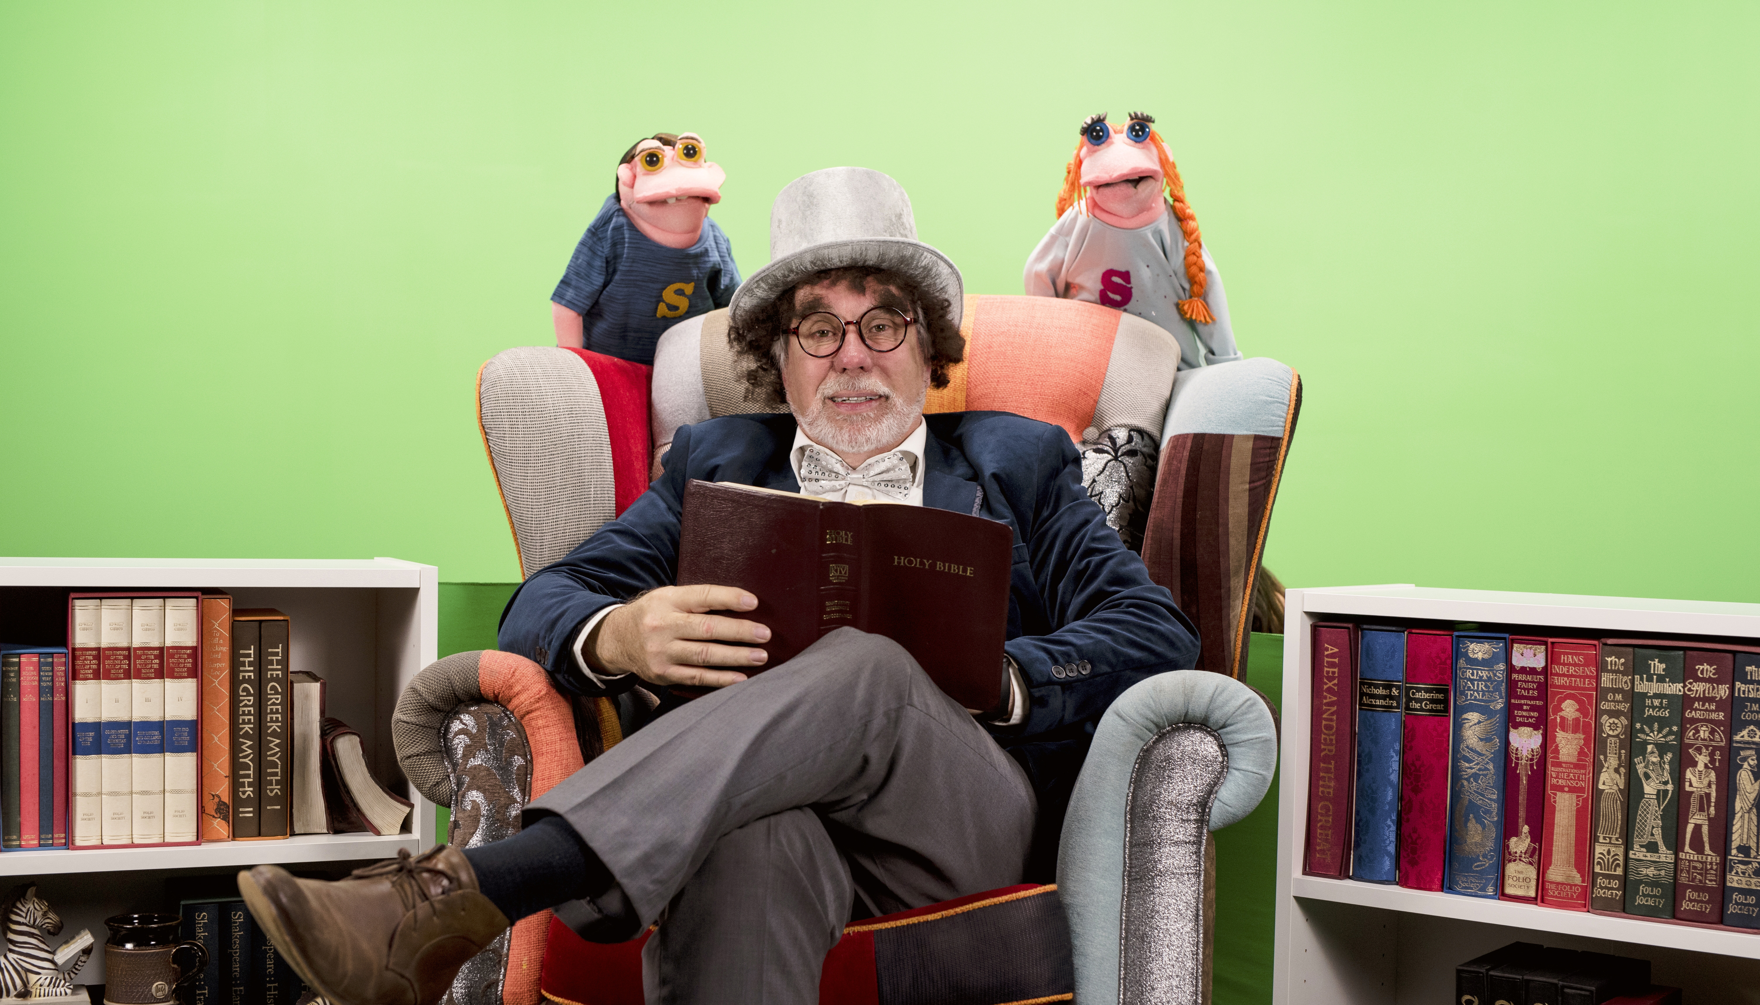

Slide 52
Daniel 3:12
¹² There are certain Jews whom you have set over the affairs of the province of Babylon: Shadrach, Meshach, and Abed-Nego; these men, O king, have not paid due regard to you. They do not serve your gods or worship the gold image which you have set up.”

Slide 53
14 “Is it true, that you do not serve my gods or worship the gold image which I have set up? ¹⁵ Now if you are ready at the time you hear the sound of the horn, flute, harp, lyre, and psaltery, in symphony with all kinds of music, and you fall down and worship the image which I have made, good!

Slide 55
Hebrews 2:14
¹⁴ Therefore, since the children (that’s all of us) share in flesh and blood, he (JESUS) likewise shared in their humanity, so that through death he could destroy the one who holds the power of death (that is, the devil), ¹⁵ and set free those who were held in slavery all their lives by their fear of death.
¹⁸ For since he himself suffered when he was tempted, he is able to help those who are tempted.

Slide 56
